Slide 1
LANGUAGE TRANSLATOR
IT011 - Butani Megha Lal (17ITUOS056)
IT012 - Chandibhamar Jenil (17ITUOS104)

Slide 2
Description
The language formulated is for ‘Imperial Conversion’ of common used units such has miles to km,gallons to litres,acres to hectares,pound to kg .
The input is given in float data type by the user of which data he/she wants to convert it into specific units.
I/P :Result of 9.5 Miles to Km
O/P : Result of 9.5 Miles to Km is 15.2855
For compiling the Lex/Yacc file we have used flex and yacc.

Slide 3
Lt.l
%{
#include<stdio.h>
#include "y.tab.h"
%}
%%
[0-9]+ {yylval.integer=atoi(yytext);
return NUMBER;}
[0-9]*\.[0-9]+ {yylval.real=(float)atof(yytext);
return FLOAT;}
Result {return Result;}
of {return of;}
to {return to;}
is {return is;}
Miles {return Miles;}
Km {return Km;}
Gallon {return Gallon;}
Litres {return Litres;}
Acres {return Acres;}
Hectares {return Hectares;}
Pound {return Pound;}
Kg {return Kg;}
[\n] {return yytext;}
[/t] ;
%%
int yywrap(){return 1;}

Slide 4
Lt.y
%{
#include<stdio.h>
#include<math.h>
#define mile2km 1.609
#define gallon2litre 3.785
#define acre2hectare 0.405
#define pound2kg 0.454
%}
%union{
int integer;
float real;
}
%token <integer> NUMBER <real> FLOAT
%token Result of is to Miles Km Gallon Litres Acres Hectares Pound Kg
%type <real> S T
%%

Slide 5
S: Result of T {$$=$3;};
T: FLOAT Miles to Km {$$= mile2km *$1;printf("Result of %f Miles to Km is %f\n",$1,$$);}
|FLOAT Gallon to Litres {$$= gallon2litre *$1;printf("Result of %f Gallon to Litres is %f\n",$1,$$);}
|FLOAT Acres to Hectares {$$= acre2hectare *$1;printf("Result of %f Acres to Hectares is %f\n",$1,$$);}
|FLOAT Pound to Kg {$$= pound2kg *$1;printf("Result of %f Pound to Kg is %f\n",$1,$$);}
;
%%
void yyerror(char *s){}
int main(int argc, char *argv[])
{
yyparse();
return 0;
}

Slide 6
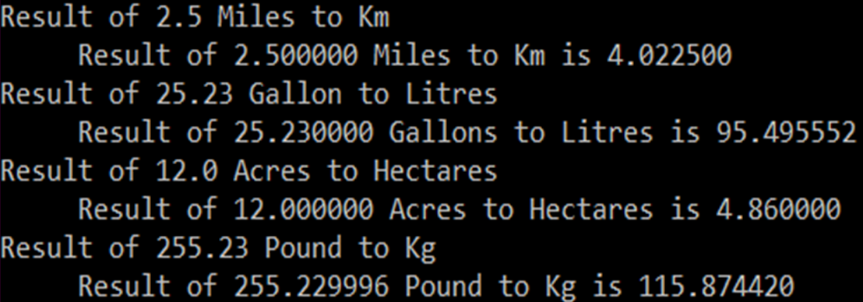
Steps to Compile And Output
Open a prompt, cd to the directory where your ".l" and ".y" are, and compile them with:
1) yacc –d Lt.y
2) flex Lt.l
3)cc lex.yy.c y.tab.c –lm
4)./a.out

